Slide 1

Chapter 14
Entity Authentication
Copyright © The McGraw-Hill Companies, Inc. Permission required for reproduction or display.

Slide 2
Chapter 14
Objectives
To distinguish between message authentication and
entity authentication
To define witnesses used for identification
To discuss some methods of entity authentication
using a password
To introduce some challenge-response protocols for
entity authentication
To introduce some zero-knowledge protocols for
entity authentication
To define biometrics and distinguish between
physiological and behavioral techniques

Slide 3
14-1 INTRODUCTION
Entity authentication is a technique designed to let one party prove the identity of another party. An entity can be a person, a process, a client, or a server. The entity whose identity needs to be proved is called the claimant; the party that tries to prove the identity of the claimant is called the verifier.
Topics discussed in this section:
14.1.1 Data-Origin Versus Entity Authentication
14.1.2 Verification Categories
14.1.3 Entity Authentication and Key Management

Slide 4
14.1.1 Data-Origin Versus Entity Authentication
There are two differences between message authentication (data-origin authentication), discussed in Chapter 13, and entity authentication, discussed in this chapter.
Message authentication might not happen in real time; entity authentication does.
Message authentication simply authenticates one message; the process needs to be repeated for each new message. Entity authentication authenticates the claimant for the entire duration of a session.

Slide 5
14.1.2 Verification Categories
Something known
Something possessed
Something inherent

Slide 6
14.1.3 Entity Authentication and Key Management
This chapter discusses entity authentication. The next chapter discusses key managment.

Slide 7
14-2 PASSWORDS
The simplest and oldest method of entity authentication is the password-based authentication, where the password is something that the claimant knows.
Topics discussed in this section:
14.2.1 Fixed Password
14.2.2 One-Time Password

Slide 8
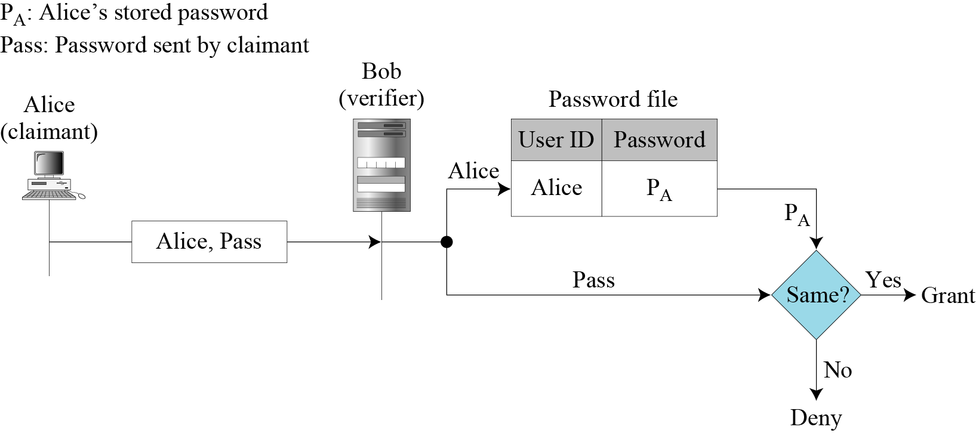
14.2.1 Fixed Password
First Approach
Figure 14.1 User ID and password file

Slide 9
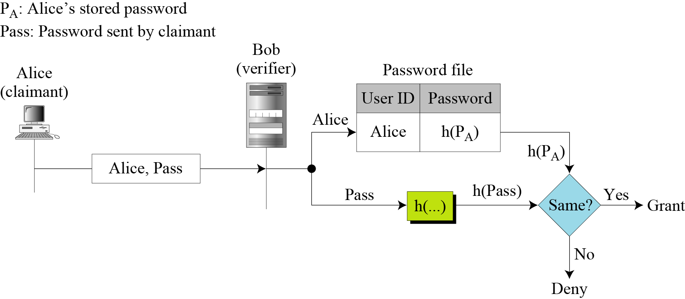
14.2.1 Continued
Second Approach
Figure 14.2 Hashing the password

Slide 10
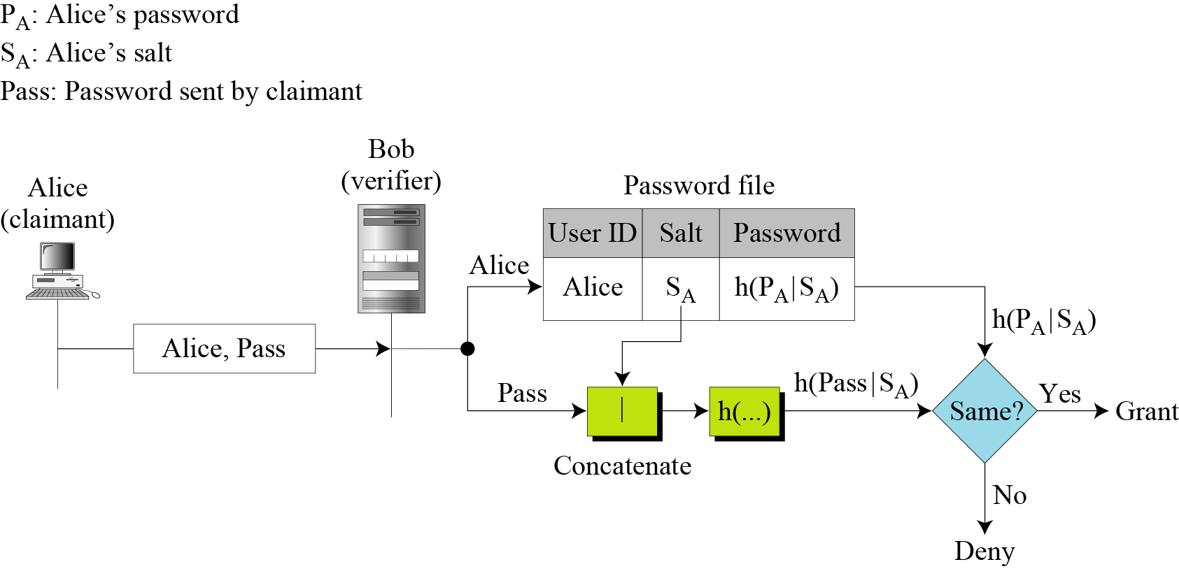
14.2.1 Continued
Third Approach
Figure 14.3 Salting the password

Slide 11
14.2.1 Continued
Fourth Approach
In the fourth approach, two identification techniques are combined. A good example of this type of authentication is the use of an ATM card with a PIN (personal identification number).

Slide 12
14.2.2 One-Time Password
First Approach
In the first approach, the user and the system agree upon a list of passwords.
Second Approach
In the second approach, the user and the system agree to sequentially update the password.
Third Approach
In the third approach, the user and the system create a sequentially updated password using a hash function.

Slide 13
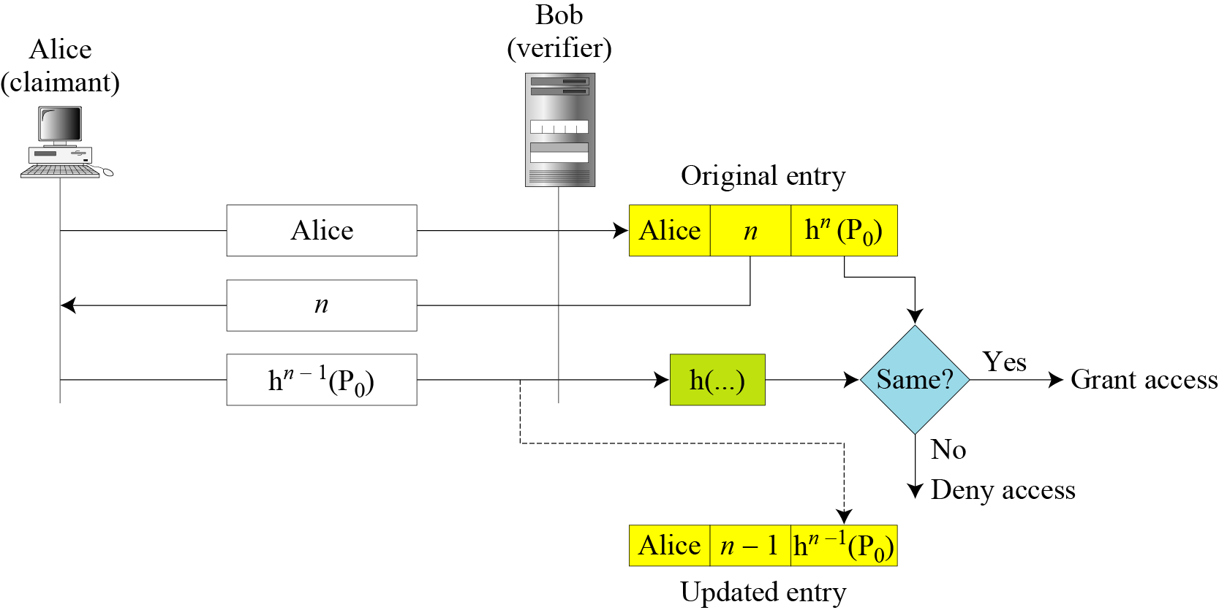
14.2.2 Continued
Figure 14.4 Lamport one-time password

Slide 14
14-3 CHALLENGE-RESPONSE
In password authentication, the claimant proves her identity by demonstrating that she knows a secret, the password. In challenge-response authentication, the claimant proves that she knows a secret without sending it.
Topics discussed in this section:
14.3.1 Using a Symmetric-Key Cipher
14.3.2 Using Keyed-Hash Functions
14.3.3 Using an Asymmetric-Key Cipher
14.3.4 Using Digital Signature

Slide 15

14-3 Continue
Note
In challenge-response authentication, the claimant proves that she knows a secret without sending it to the verifier.
Note
The challenge is a time-varying value sent by the verifier; the response is the result
of a function applied on the challenge.

Slide 16
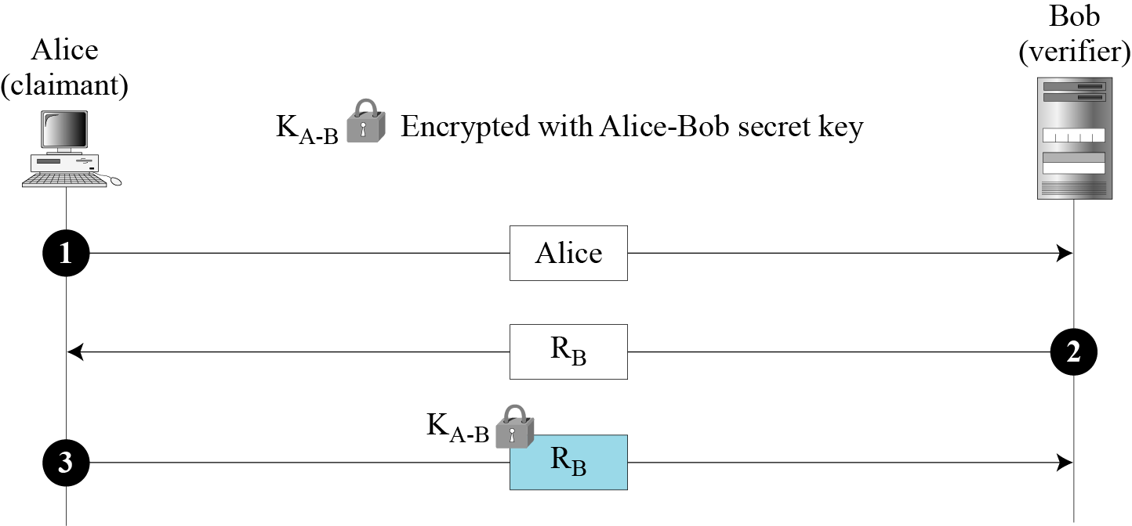
14.3.1 Using a Symmetric-Key Cipher
First Approach
Figure 14.5 Nonce challenge

Slide 17
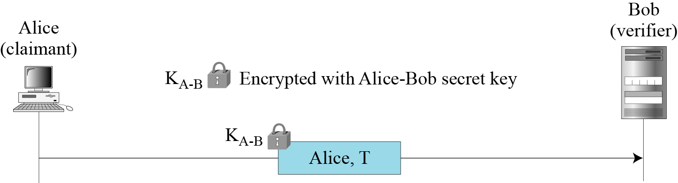
14.3.1 Continued
Second Approach
Figure 14.6 Timestamp challenge

Slide 18
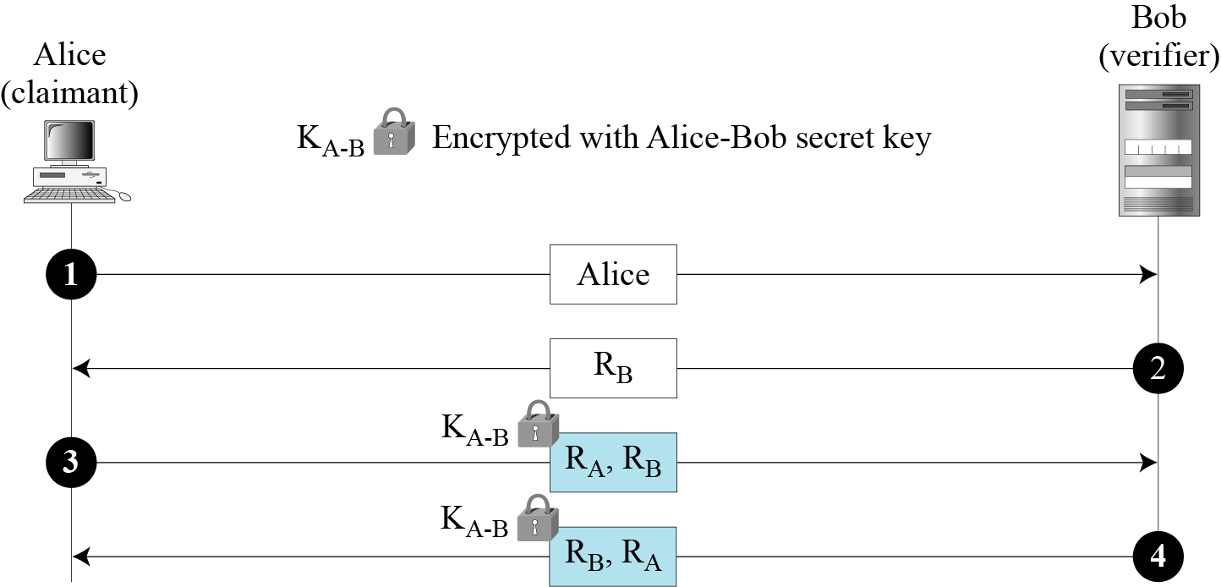
14.3.1 Continued
Third Approach.
Figure 14.7 Bidirectional authentication

Slide 19
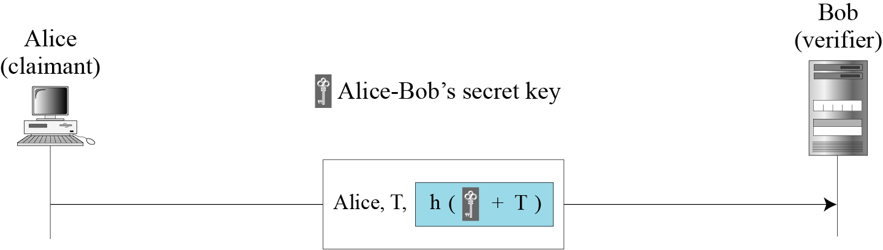
14.3.2 Using Keyed-Hash Functions
Instead of using encryption/decryption for entity authentication, we can also use a keyed-hash function (MAC).
Figure 14.8 Keyed-hash function

Slide 20
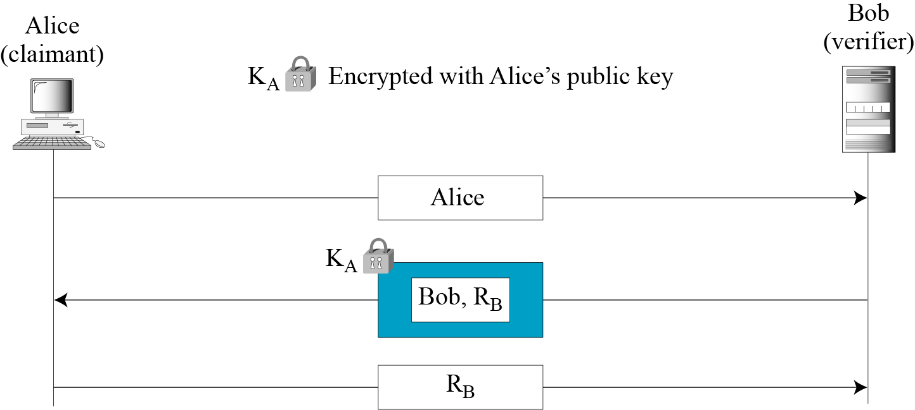
14.3.3 Using an Asymmetric-Key Cipher
First Approach
Figure 14.9 Unidirectional, asymmetric-key authentication

Slide 21
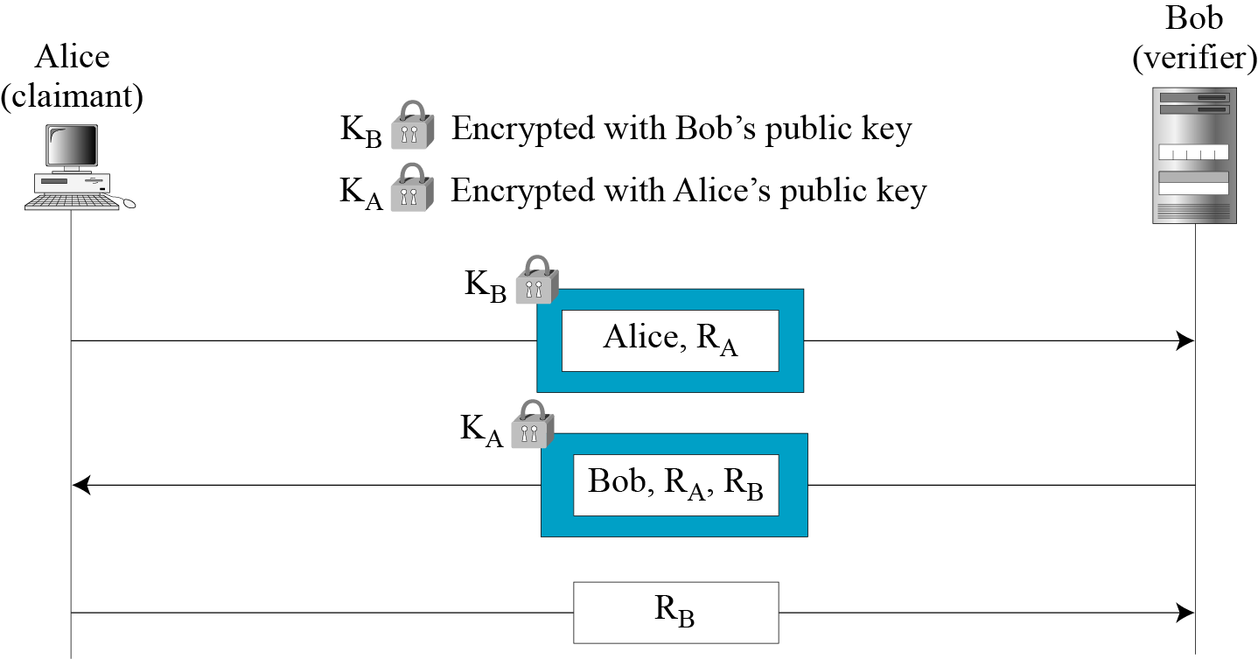
14.3.3 Continued
Second Approach
Figure 14.10 Bidirectional, asymmetric-key

Slide 22
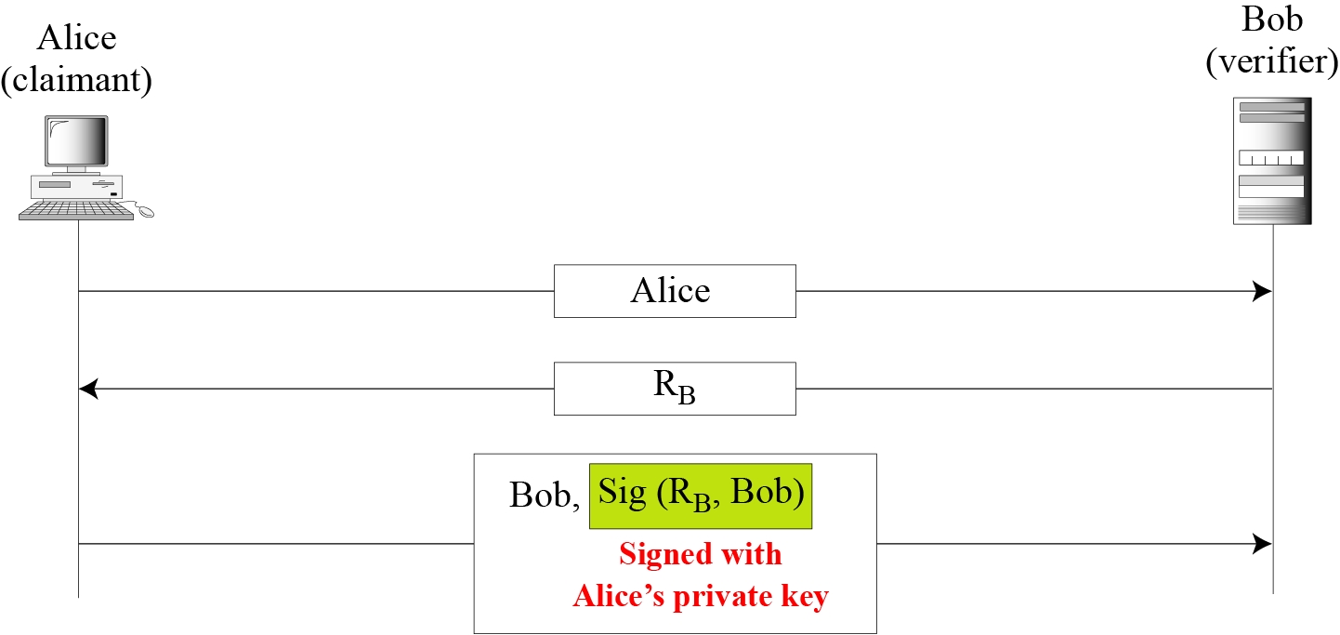
14.3.4 Using Digital Signature
First Approach
Figure 14.11 Digital signature, unidirectional

Slide 23
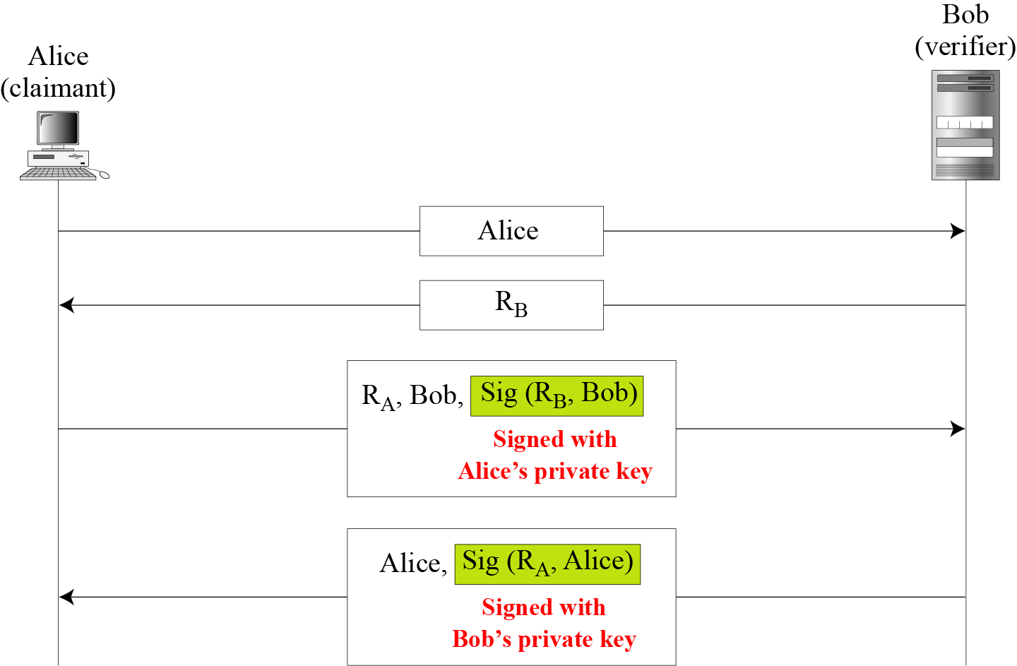
14.3.4 Continued
Second Approach
Figure 14.12 Digital signature, bidirectional authentication

Slide 24
14-4 ZERO-KNOWLEDGE
In zero-knowledge authentication, the claimant does not reveal anything that might endanger the confidentiality of the secret. The claimant proves to the verifier that she knows a secret, without revealing it. The interactions are so designed that they cannot lead to revealing or guessing the secret.
Topics discussed in this section:
14.4.1 Fiat-Shamir Protocol
14.4.2 Feige-Fiat-Shamir Protocol
14.4.3 Guillou-Quisquater Protocol

Slide 25
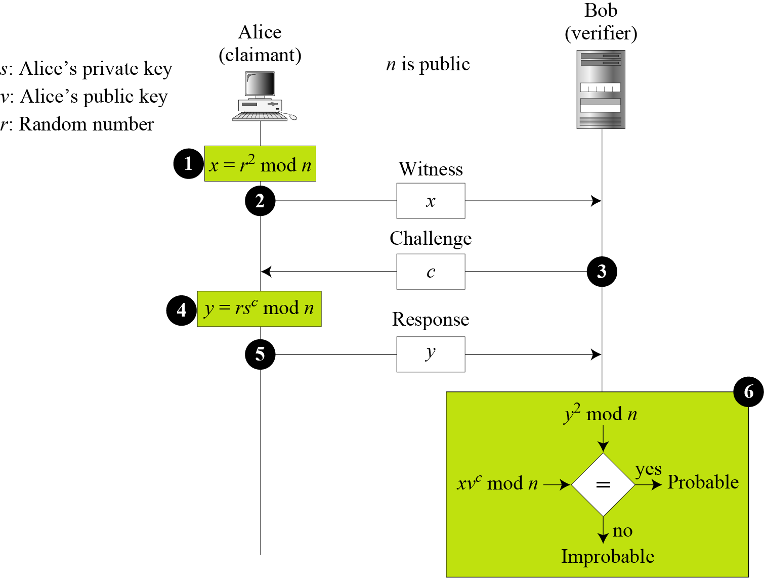
14.4.1 Fiat-Shamir Protocol
Figure 14.13 Fiat-Shamir protocol

Slide 26
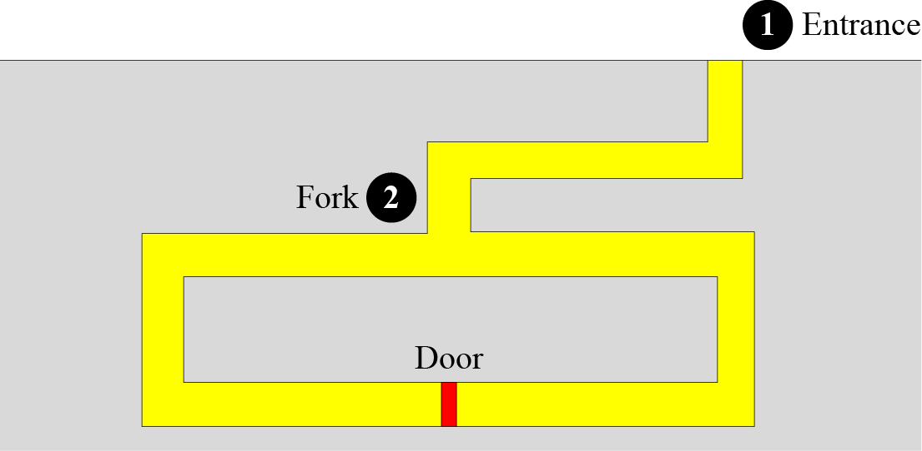
14.4.1 Continued
Cave Example
Figure 14.14 Cave example

Slide 27
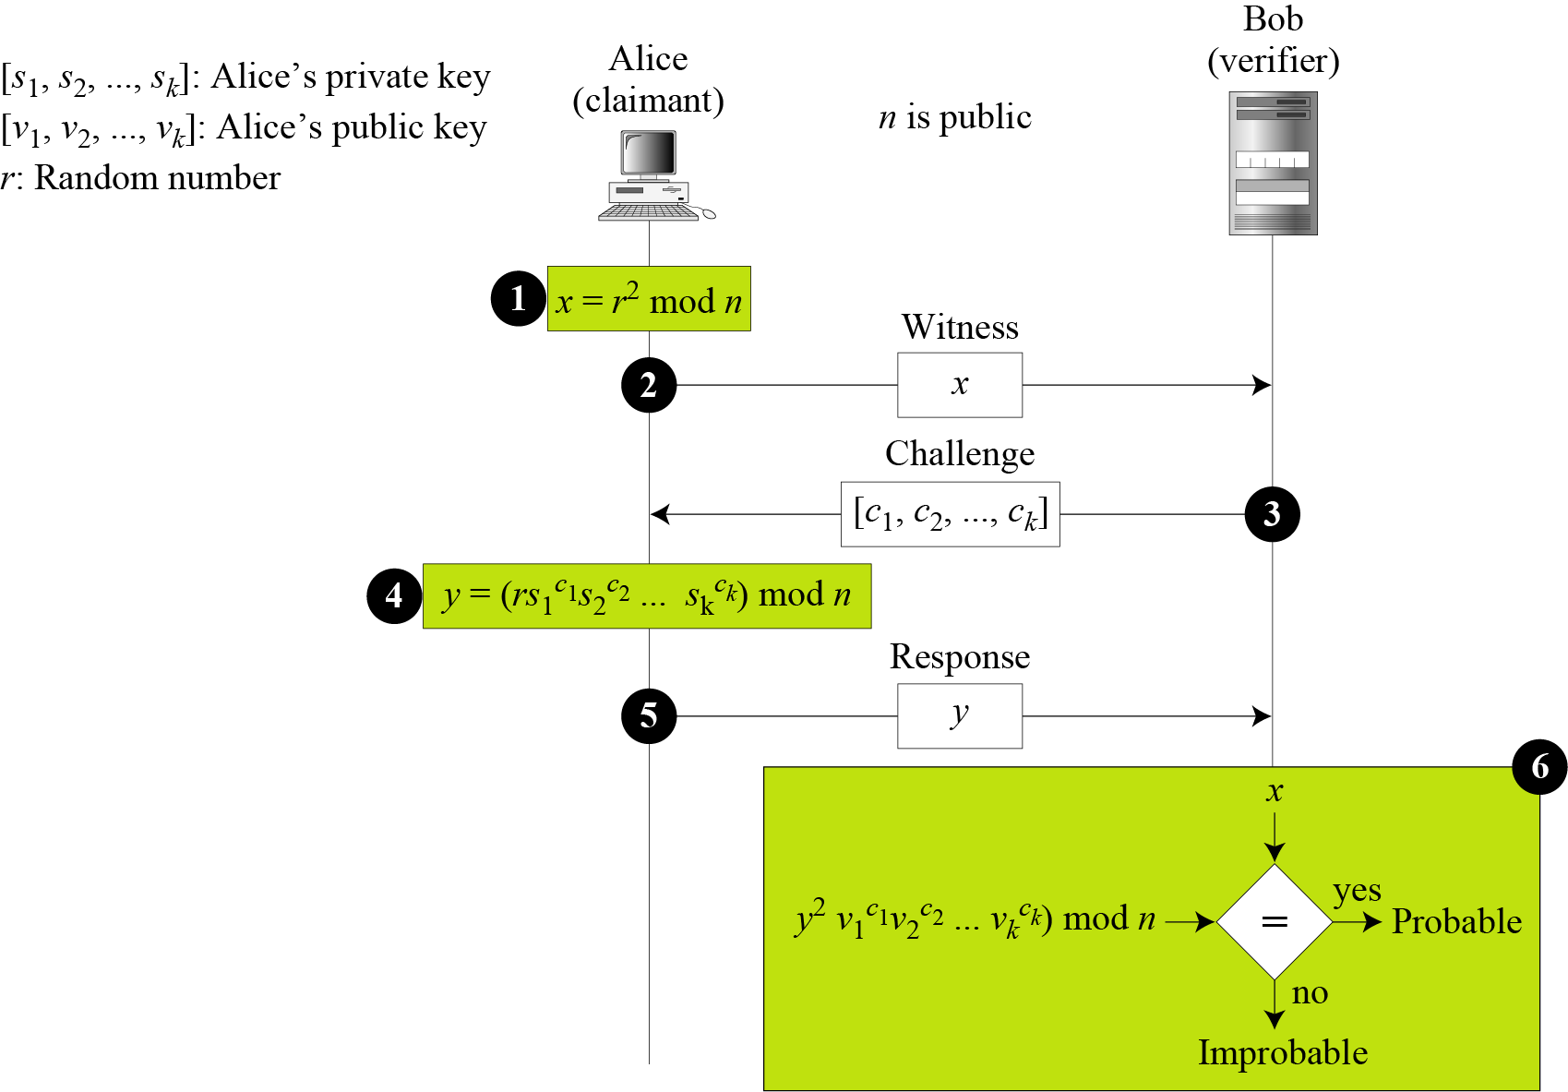
14.4.2 Feige-Fiat-Shamir Protocol
Figure 14.15 Feige-Fiat-Shamir protocol

Slide 28
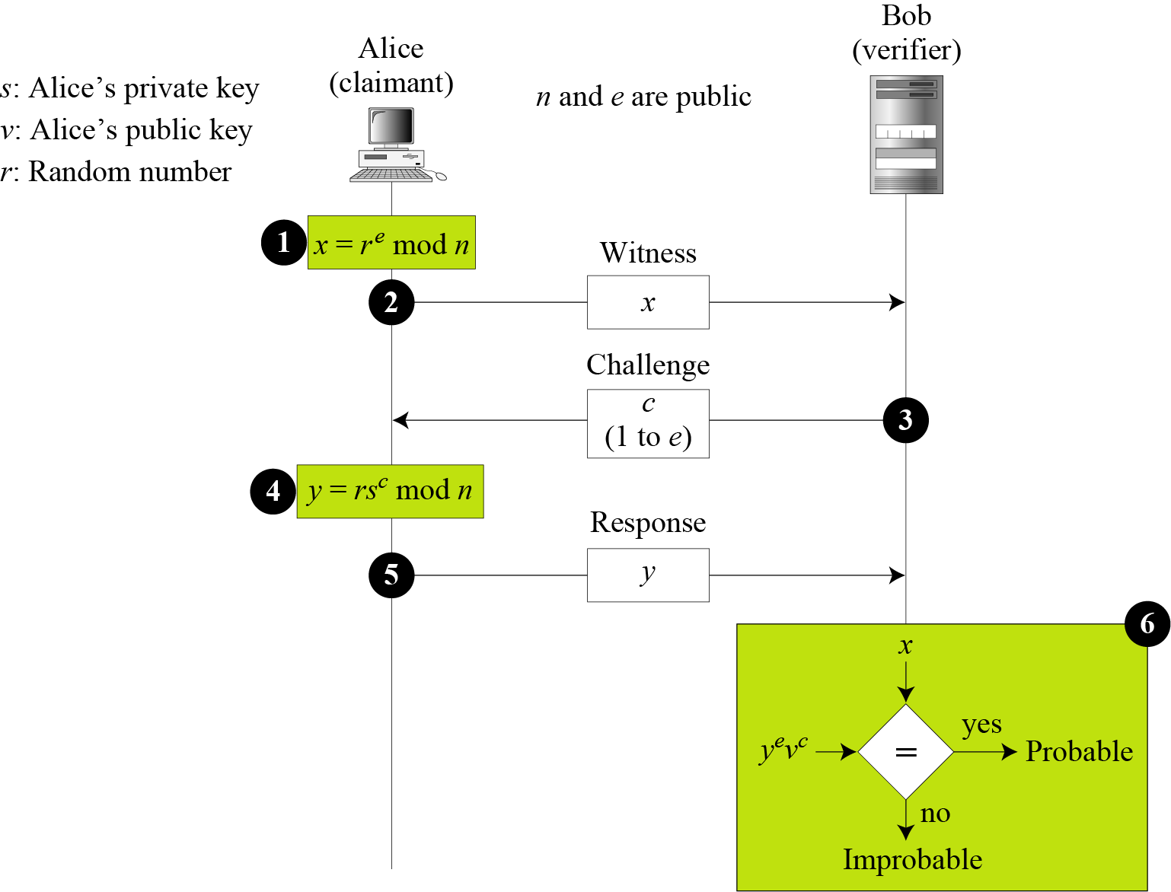
14.4.3 Guillou-Quisquater Protocol
Figure 14.16 Guillou-Quisquater protocol

Slide 29
14.4.3 Continued
Figure 14.16 Guillou-Quisquater protocol

Slide 30
14-5 BIOMETRICS
Biometrics is the measurement of physiological or behavioral features that identify a person (authentication by something inherent). Biometrics measures features that cannot be guessed, stolen, or shared.
Topics discussed in this section:
14.5.1 Components
14.5.2 Enrollment
14.5.3 Authentication
14.5.4 Techniques
14.5.5 Accuracy
14.5.6 Applications

Slide 31
14.5.1 Components
Several components are needed for biometrics, including capturing devices, processors, and storage devices..

Slide 32
14.5.2 Enrollment
Before using any biometric techniques for authentication, the corresponding feature of each person in the community should be available in the database. This is referred to as enrollment.

Slide 33
14.5.3 Authentication
Verification
Identification

Slide 34
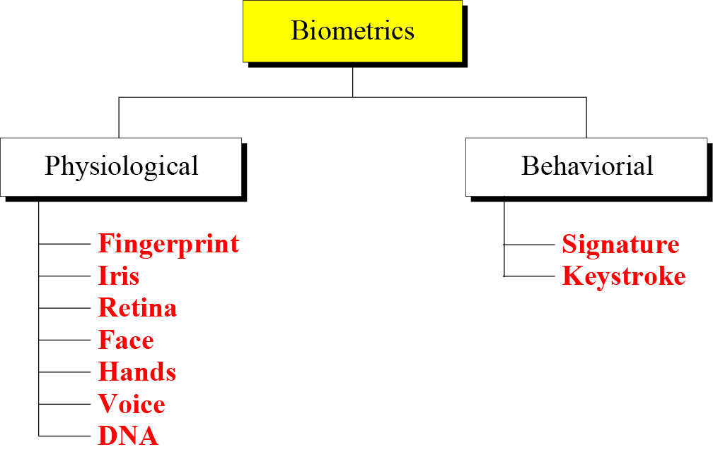
14.5.4 Techniques
Figure 14.17 Techniques

Slide 35
14.5.4 Continued
Physiological Techniques
Fingerprint
Hands
Iris
Voice
Retina
DNA
Face

Slide 36
14.5.4 Continued
Behavioral Techniques
Signature
Keystroke

Slide 37
14.5.5 Accuracy
False Rejection Rate (FRR)
False Acceptance Rate (FAR)

Slide 38
14.5.6 Applications
Several applications of biometrics are already in use. In commercial environments, these include access to facilities, access to information systems, transaction at point-ofsales, and employee timekeeping. In the law enforcement system, they include investigations (using fingerprints or DNA) and forensic analysis. Border control and immigration control also use some biometric techniques.

